Slide 1
U14s BLACK
Coach Ryan Anderson

Slide 2
EXPECTATIONS
COACH (MY EXPECTATIONS FROM PLAYERS)
PLAYERS
100% EFFORT AT ALL TIMES!!
COMMUNICATION
EFFORT OVER OUTCOMES
ACEs (On the website, under about us/coaching)
ATTITUDE
COMMITMENT
EXCELLENCE
You should expect the following:
Coaches that care about YOU.
Sessions that target your weaknesses.
Support in every aspect of the game.
Be ready to give 110% regardless of the situation.

Slide 3
GOALS
COACHES (Coaches target for the season)
TEAM (Coaches goal for the team)
Ryan – To develop the team up to a standard where each player feels comfortable performing a range of skills in a competitive environment.
Lewis – To learn from the coaches/players and create his own coaching philosophy, and improve confidence in delivery.
Leam – Be able to stretch himself and his knowledge to cater for ALL players.
Each game has a progression of development, with specific areas of focus.
A combined FAMILY ethos, where we commend each other on effort and ideas, not just outcomes.
Hold each other accountable for development, communication and effort.

Slide 4
PLAYER GOALS
(each player will give their own goal for the season)

Slide 5
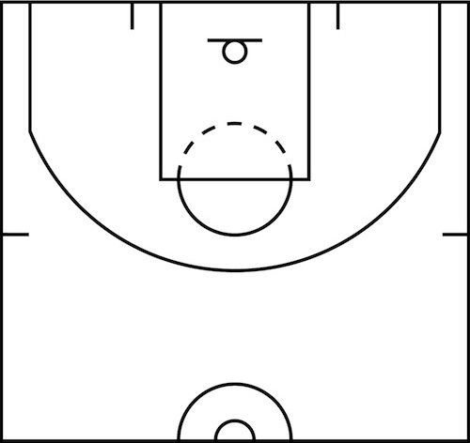
DEFENCE
We will play a MAN TO MAN PROACTIVE defence.
NO RED ZONE
PUSH POINTS
SHOT SECTORS
REBOUNDING
SPACING
Notes:
NO RED ZONE
Means DO NOT LET OTHER TEAM IN THE CENTRE SECTION OF THE COURT.
This is at all times. Push them to the side by shaping your body to turn them into one of the wider channels. 0
PUSH POINTS
These specified points are where we want to push the opposition players with the ball. By doing this, you not only get them segmented onto one side of the court, but you also limit their capacity to see the whole floor. They naturally gravitate to the side they are dribbling towards for a pass.
We use the side lines/end lines as extra defenders. This allows us to cut off players, and by not allowing the switch back towards the red zone, the players become isolated.
SHOT SECTORS
We want the other team to shoot from the green circles if we can (or further away from the hoop, but if they penetrate we want these shots).
Low percentage of shots success from these locations at lower age groups when contested. Easy to rebound as ball normally falls into charge circle or towards opposite shot sector.
REBOUNDING
We need to ensure rebounding is TOP PRIORITY when on defence. If we can play NO RED ZONE efficiently, then rebounding will be easier to predict. By positioning players under the hoop in the charge circle, taking two steps back and knowing the ball will fall their way, we should be able to win the rebounding battle. This is an ATTITUDE issue though. All players need to want to rebound.
After a rebound, we find our ball handler and outlet FAST. This leads to the offence.
SPACING
All players need to maintain a level of spacing when playing defence. Below are the instructions
YOUR MAN HAS THE BALL
You are on your man, using your body shape and defensive stance to push them either side to a push point. NO RED ZONE
YOUR MAN IS ONE PASS AWAY FROM THE BALL
You are one step away from your man, and you are in ball denial mode. You should be able to intercept if a pass is made, but not be so close you are beating by cuts to the basket. ALWAYS SEE MAN AND BALL.
YOUR MAN IS AWAY FROM THE BALL (WEAKSIDE)
You are spaced away from your man playing help side defence. See man and ball. Protect the paint.
NOTE: u14s are not allowed to play zone so the amount of help defence you can play is limited. U16s do not have this rule, and as such can sit in under th ebasket if their man is the weakside corner if they wanted to. Please adjust your defence accordingly.

Slide 6
OFFENCE
We will play a fast paced, inclusive, pass first offence.
FAST BREAKS
RUN LANES (Left, mid, right)
STAY HIGH
DRIVE TO THE BASKET
Notes:
FAST PACED INCLUSIVE PASS FIRST OFFENCE
This means we want to rebound and outlet fast, taking advantage of the transition between defence to offence. With this in mind, you will make mistakes and create turnovers, but if the IDEA was correct, then this is ok. i.e. passing ahead to open runner, but throwing too long and out of bounds. WHAT IS NOT CORRECT, is trying to dribble through everyone and taking a ONE PASS OFFENCE. This should never happen unless the fast break opportunity results in an open layup. We focus on fast transition, into a passing offence. His ensures all players are involved, but also shifts the defence. By causing the defence to act quickly, you are presented with mismatches as well as opportunities close to the rim. Inclusiveness is key, as this means all players will be asked to have the same attitude towards offence. If you are open and in the key, shoot. If you have players that are able to shoot longer distance, this rule also applies (i.e. Olly cornes, lennon).
RUN LANES
This follows the defensive principal of a three sector court, left mid and right. Running wide in these lanes allows gaps to form in the half space, where players can drive from the wings or the central positions with a direct route to the hoop. Should this fail, it then allows a fall back to spacing that keeps a large enough gap for any players to recognise and penetrate opposition. WE WANT TO GET TO THE HOOP.
STAY HIGH
By doing this, you create space in behind for cuts, drives and outlets. Example, if player 5 on right wing drives, yet gets double teamed, he will have a release at the free throw line or the near side PG slot. However, this help will come late due to the high nature of players spacing. Imagine a player helping from the corner, compared to helping from a high wing. More distance for the Defence means more time to get a shot off in the green shot sector.
DRIVE TO THE BASKET
Emphasis on this. The better this goes, the more space you actually create. When you drive to the hoops, the defence is forced to collapse to rebound, thus we can kick out and get either open shots, or a secondary drive. Rinse and repeat to generate bigger gaps and more mismatches.
NOTE: Spacing is dependant on the players you have. I.e. Matt if you have a 7 footer, put him closer to the hoop, but realise when you do this you place a barrier in the driving lane.

